Slide 1


Yogita Gohiya
23-10-2025

Slide 2

Outline
Executive Summary
Introduction
Methodology
Results
Conclusion
Appendix

Slide 3
Executive Summary
Summary of Methodologies
Collected and cleaned SpaceX launch data
Performed EDA to find key factors affecting landing success
Built and tested ML models (Logistic Regression, Decision Tree, SVM, Random Forest)
Evaluated models using accuracy
Summary of Results
EDA Results
Interactive Analytics
Predictive Analytics

Slide 4
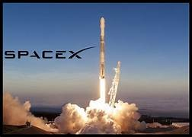
Introduction
Background:
SpaceX revolutionized space launches by reusing rocket stages, drastically reducing costs — about $62M per launch compared to $165M for competitors. Its success in recovering the Falcon 9 first stage since 2010 has drawn global attention.
Business Problem:
Launch cost depends on whether the first stage lands successfully. Predicting this outcome helps estimate costs and understand SpaceX’s pricing edge. Competing companies can use this insight to optimize bids and pricing strategies.

Slide 5

Section 1

Slide 6
Methodology
Executive Summary
Data Collection & Wrangling
Collected launch data from SpaceX API and Wikipedia
Cleaned and transformed data (handled missing values, encoded categories)
Exploratory Data Analysis (EDA)
Used visualizations and SQL queries to find trends and key factors
Explored payload, orbit type, launch site, and success rate relationship
Interactive Visual Analytics
Built Folium maps to show launch locations and landing outcomes
Created Plotly Dash dashboard for interactive exploration
Predictive Analysis
Applied classification models (Logistic Regression, SVM, KNN, Decision Tree)
Tuned models using Grid Search and evaluated with accuracy
Identified best model for predicting landing success

Slide 7
Data Collection
Data Sources:
SpaceX API – official launch data (dates, payload, rocket type, launch outcome)
Wikipedia – supplementary data (orbit type, landing location, booster version)
Tools Used:
Python libraries: requests, pandas, BeautifulSoup
API calls for JSON data retrieval
Web scraping for additional launch info
Process Summary:
Access SpaceX REST API → Retrieve raw launch data in JSON format
Web Scraping (Wikipedia) → Collect missing attributes (orbit, landing type)
Combine Datasets → Merge API and scraped data
Data Cleaning → Handle missing values & standardize formats
Store Dataset → Save as CSV for further analysis

Slide 8
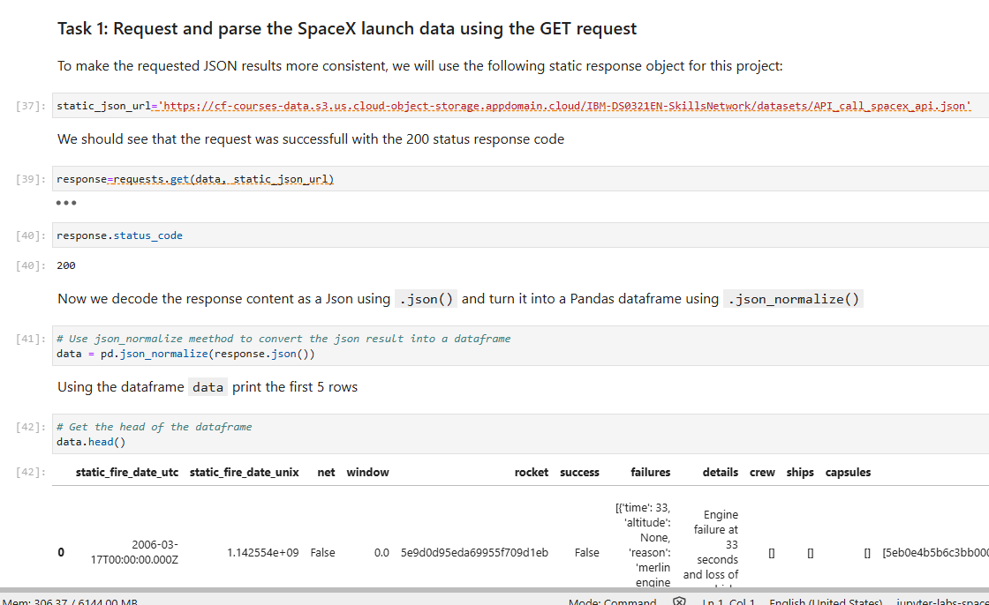
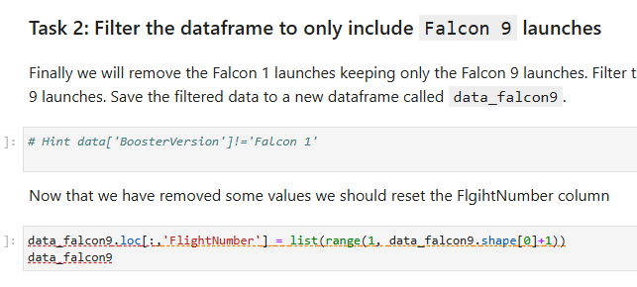
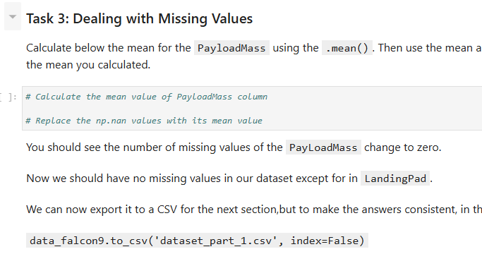
Data Collection – SpaceX API
Request and parse the SpaceX launch data using the GET request
Filter the dataframe to only include Falcon 9 launches
Dealing with Missing Values
GitHub URL : https://github.com/YogitaGohiya/Space-X-Falcon-9-First-Stage-Landing-Prediction/blob/main/spacex-data-collection-api.ipynb

Slide 9
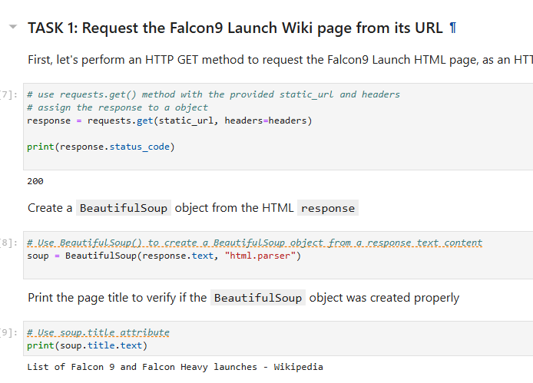
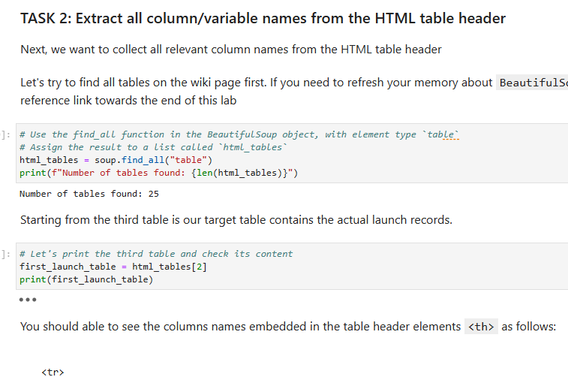
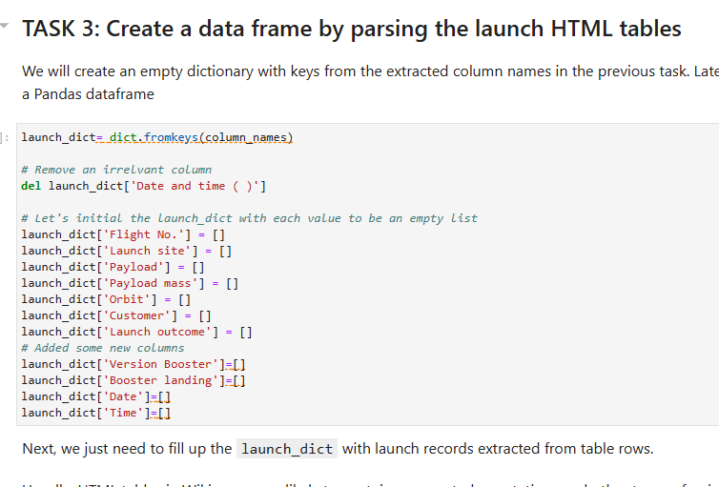
Data Collection - Scraping
Request the Falcon9 Launch Wiki page from its URL
Extract all column/variable names from the HTML table header
Create a data frame by parsing the launch HTML tables
GitHub URL : https://github.com/YogitaGohiya/Space-X-Falcon-9-First-Stage-Landing-Prediction/blob/main/webscraping.ipynb

Slide 10
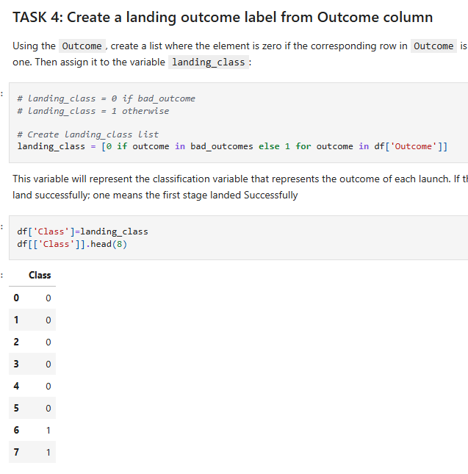
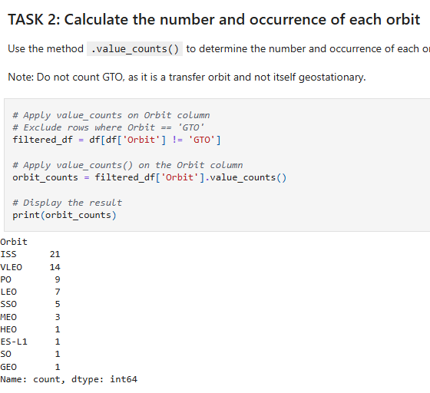
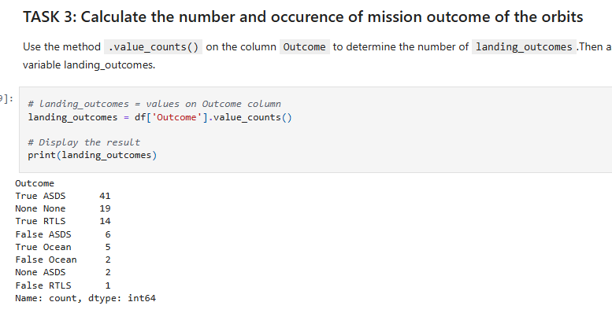
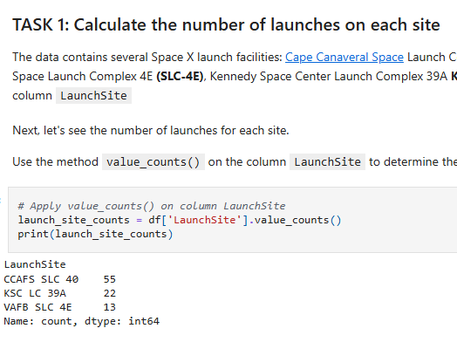
Data Wrangling
Process of cleaning and transforming raw data into a usable format
Calculate the number and occurrence of each orbit
Calculate the number and occurence of mission outcome of the orbits
Create a landing outcome label from Outcome column
Calculate the number of launches on each site
GitHub URL : https://github.com/YogitaGohiya/Space-X-Falcon-9-First-Stage-Landing-Prediction/blob/main/spacex-Data%20wrangling.ipynb

Slide 11
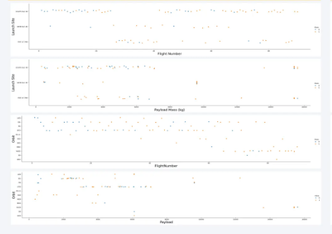
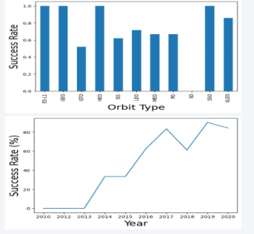
EDA with Data Visualization
Using scatter point chart visualize relationship between
Flight Number and Launch Site
Payload Mass and Launch Site
FlightNumber and Orbit type
Payload Mass and Orbit type
Bar chart for success rate of each orbit type
Line chart for launch success yearly trend
GitHub URL https://github.com/YogitaGohiya/Space-X-Falcon-9-First-Stage-Landing-Prediction/blob/main/EDA%20with%20Visualization%20Lab.ipynb

Slide 12
EDA with SQL
Display the names of the unique launch sites in the space mission
Display 5 records where launch sites begin with the string 'CCA'
Display the total payload mass carried by boosters launched by NASA (CRS)
Display average payload mass carried by booster version F9 v1.1
List the date when the first succesful landing outcome in ground pad was acheived.
List the names of the boosters which have success in drone ship and have payload mass greater than 4000 but less than 6000
List the total number of successful and failure mission outcomes
List all the booster_versions that have carried the maximum payload mass, using a subquery with a suitable aggregate function.
List the records which will display the month names, failure landing_outcomes in drone ship ,booster versions, launch_site for the months in year 2015.
Rank the count of landing outcomes (such as Failure (drone ship) or Success (ground pad)) between the date 2010-06-04 and 2017-03-20, in descending order.
GitHub URL: https://github.com/YogitaGohiya/Space-X-Falcon-9-First-Stage-Landing-Prediction/blob/main/eda-sql.ipynb

Slide 13
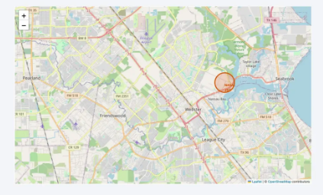
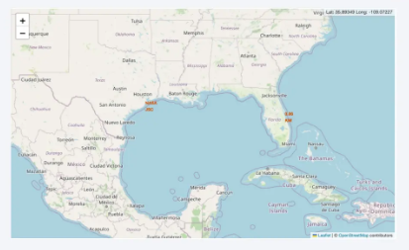
Build an Interactive Map with Folium
Purpose
To visually identify where launches occur across different sites
To analyze success patterns by location and visualize reusability performance
To make data interactive and intuitive for understanding geographical impact on landing success reference and peer-review purpose
Distance marker to show distances between
a launch site to its proximities
Circle marker at NASA Johnson Space Center's coordinate
GitHub URL: https://github.com/YogitaGohiya/Space-X-Falcon-9-First-Stage-Landing-Prediction/blob/main/eda-sql.ipynb

Slide 14
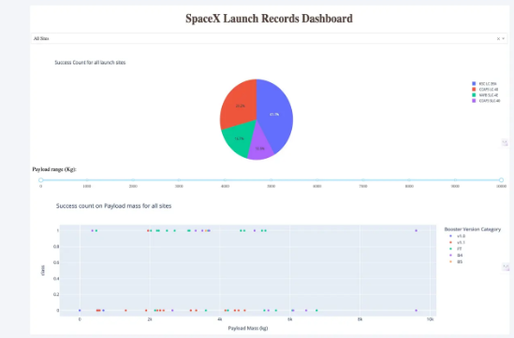
Build a Dashboard with Plotly Dash
Dropdown option of a pie chart created to visualize
Successful launches of each site
Scatter point with a Range Slider to Select Payload to visualize Successful launches
GitHub URL: https://github.com/YogitaGohiya/Space-X-Falcon-9-First-Stage-Landing-Prediction/blob/main/dashboard%20spacex

Slide 15
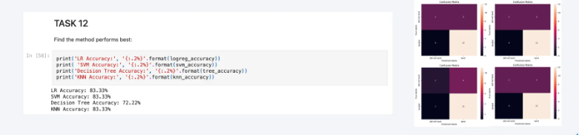
Predictive Analysis (Classification)
To predict if the Falcon 9 first stage will land successfully we used Logistic Regression, Decision Tree, K-Nearest Neighbors (KNN), Support Vector Machine (SVM)
Steps:
Split Data – Train/test split for unbiased evaluation
Build Models – Train multiple classification models
Evaluate Models – Compare accuracy(highest 83.33%)
Tune Hyperparameters – Use GridSearchCV for optimal settings
Select Best Model – Choose the highest-performing classifier
GitHub URL: https://github.com/YogitaGohiya/Space-X-Falcon-9-First-Stage-Landing-Prediction/blob/main/SpaceX_Machine%20Learning%20Prediction_Part_5%20(1).ipynb

Slide 16
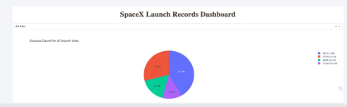
Results
Top Models: LR, SVM, and KNN gave the best prediction performance
Lighter Payloads: Higher success rates than heavier ones
Best Site & Orbits: KSC LC-39A and GEO/HEO/SSO/ES L1 orbits show the most successful launches
KSC LC-39A has the most successful launches overall

Slide 17

Section 2

Slide 18
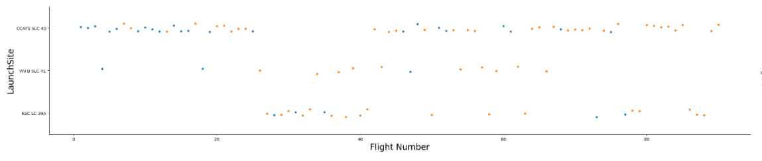
Flight Number vs. Launch Site
CCAFS SLC-40 recorded the highest number of launches among all launch sites.

Slide 19
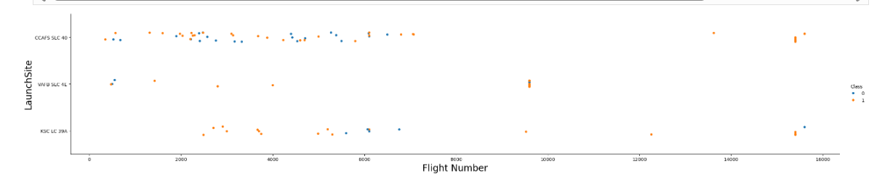
Payload vs. Launch Site
Payloads with lower mass are have more launches compared to those with higher mass across all three launch sites

Slide 20
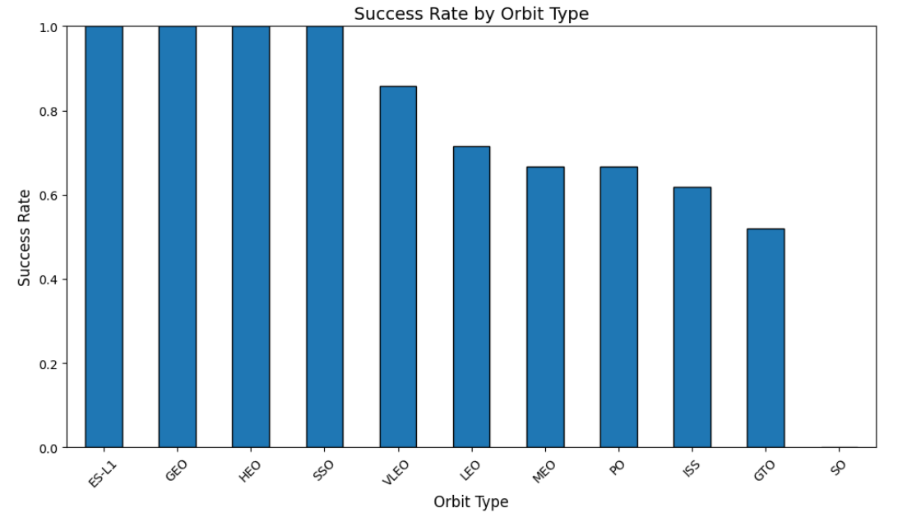
Success Rate vs. Orbit Type
Orbit types ES-L 1,GEO,HEO,SSO have the highest success rate among all

Slide 21
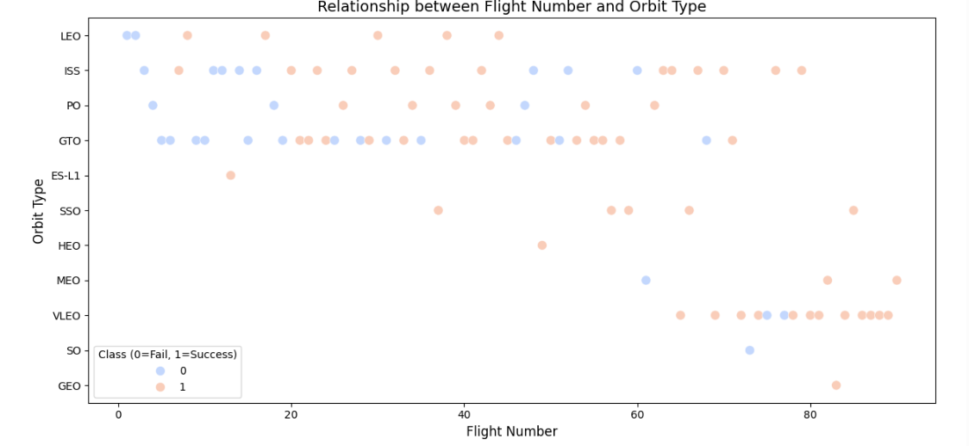
Flight Number vs. Orbit Type
LEO orbit, success seems to be related to the number of flights. Conversely, in the GTO orbit, there appears to be no relationship between flight number and success

Slide 22
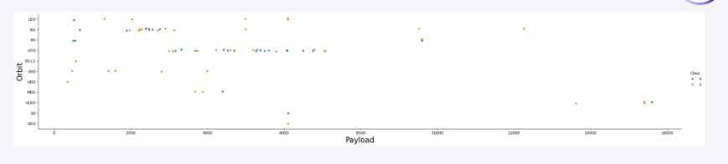
Payload vs. Orbit Type
With heavy payloads the successful landing or positive landing rate are more for Polar,LEO and ISS.
However, for GTO, it's difficult to distinguish between successful and unsuccessful landings as both outcomes are present.

Slide 23
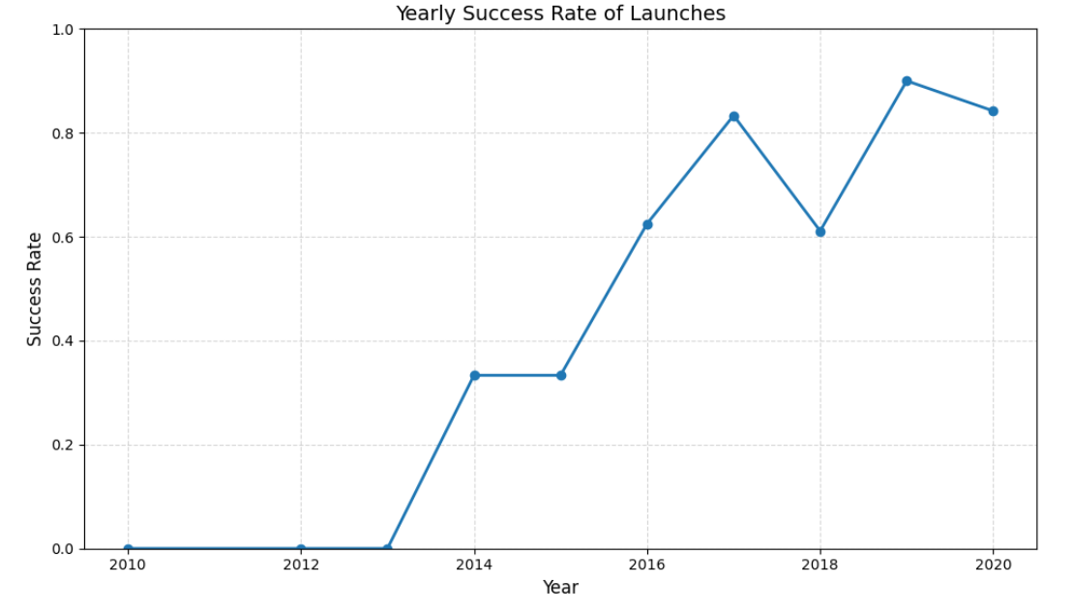
Launch Success Yearly Trend
Observed that the success rate since 2013 kept increasing till 2020

Slide 24
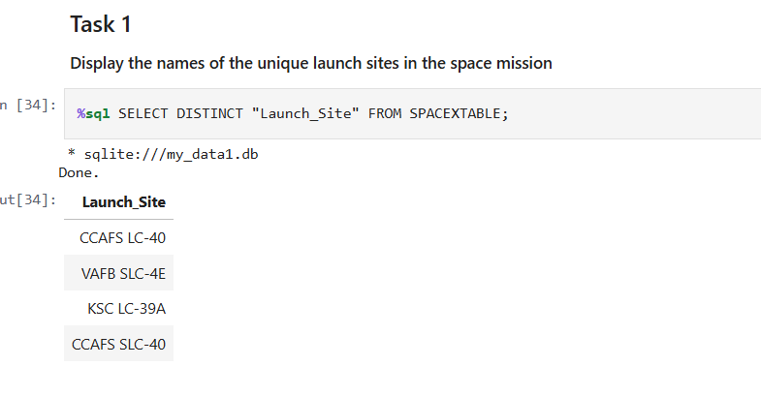
All Launch Site Names
Performed an SQL query to obtain all launch site names

Slide 25
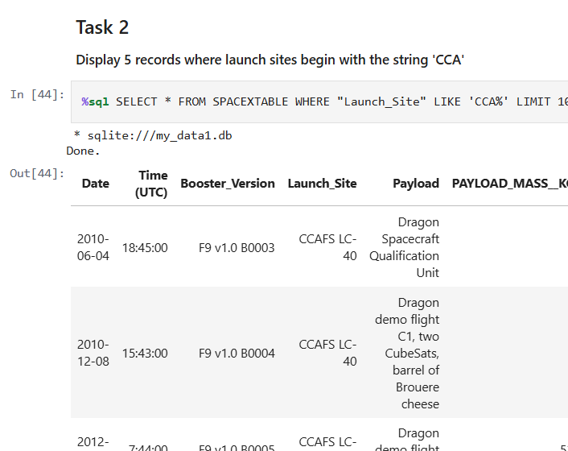
Launch Site Names Begin with 'CCA'
Performed an SQL query to obtain 5 launch site names that begin with 'CCA'

Slide 26
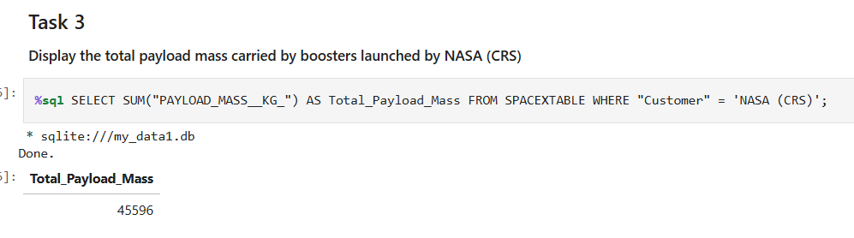
Total Payload Mass
Performed an SQL query to display the total payload mass carried by boosters launched by NASA (CRS)

Slide 27
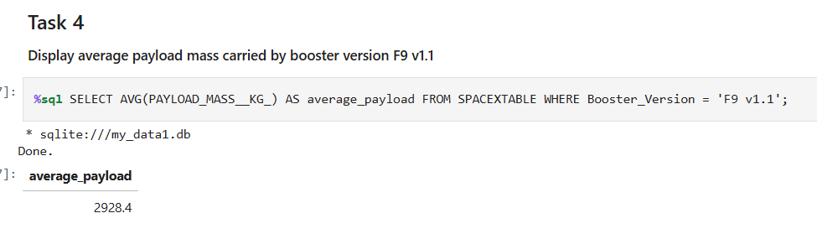
Average Payload Mass by F9 v1.1
Performed an SQL query to display average payload mass carried by booster version F9 v1.1

Slide 28
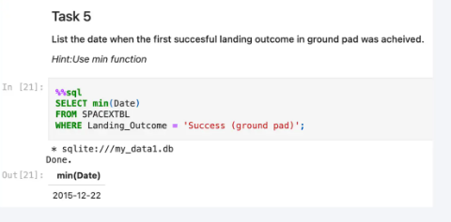
First Successful Ground Landing Date
Performed an SQL query to list the date when the first succesful landing outcome in ground pad was acheived

Slide 29
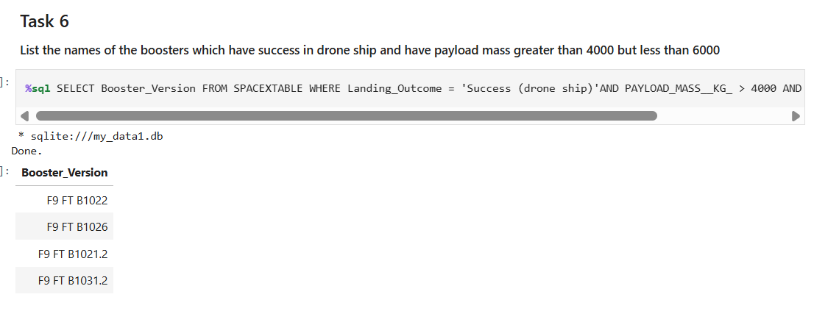
Successful Drone Ship Landing with Payload between 4000 and 6000
Performed an SQL query to list the names of the boosters which have success in drone ship and have payload mass greater than 4000 but less than 6000

Slide 30
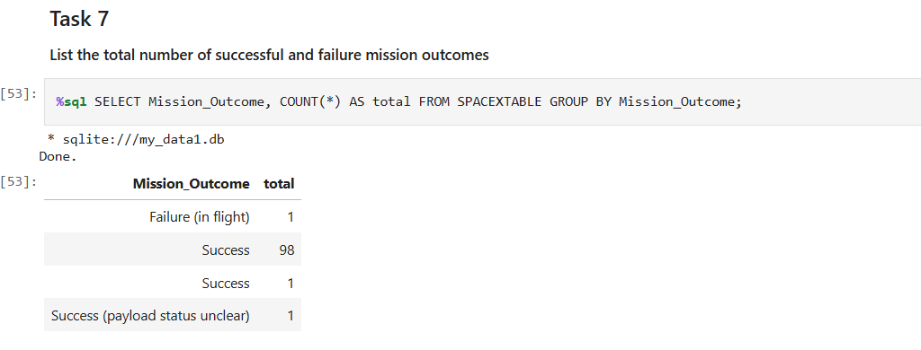
Total Number of Successful and Failure Mission Outcomes
Performed an SQL query to List the total number of successful and failure mission outcomes

Slide 31
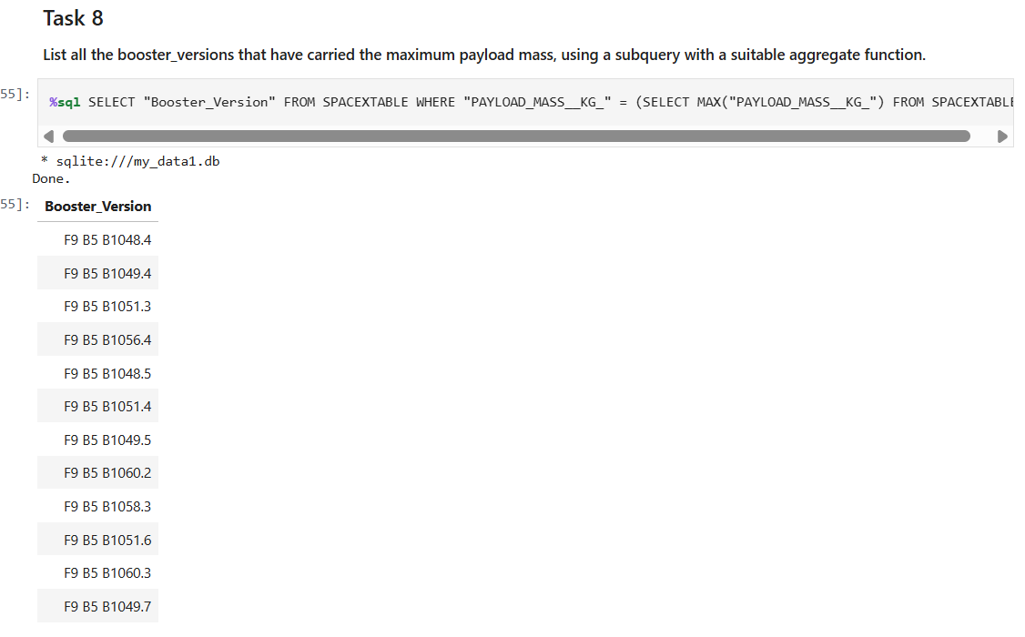
Boosters Carried Maximum Payload
Performed an SQL query to List all the booster_versions that have carried the maximum payload mass, using a subquery with a suitable aggregate function.

Slide 32
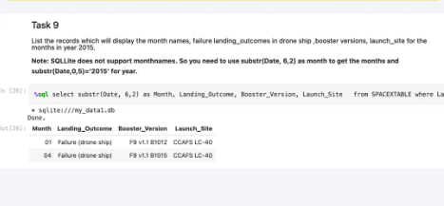
2015 Launch Records
Performed an SQL query to List the records which will display the month names, failure landing_outcomes in drone ship ,booster versions, launch_site for the months in year 2015.

Slide 33
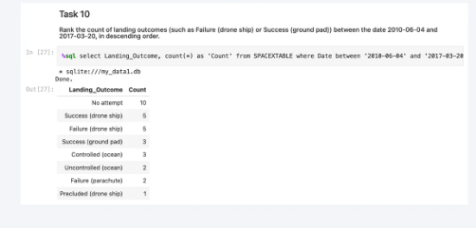
Rank Landing Outcomes Between 2010-06-04 and 2017-03-20
Performed an SQL query to Rank the count of landing outcomes (such as Failure (drone ship) or Success (ground pad)) between the date 2010-06-04 and 2017-03-20, in descending order

Slide 34

Section 3

Slide 35
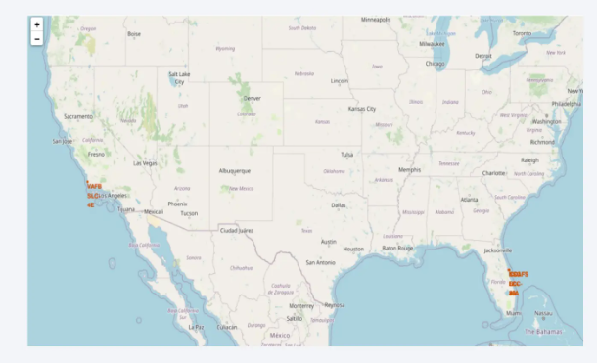
All launch sites on a map
The launch sites are labelled by a marker with their names on the map

Slide 36
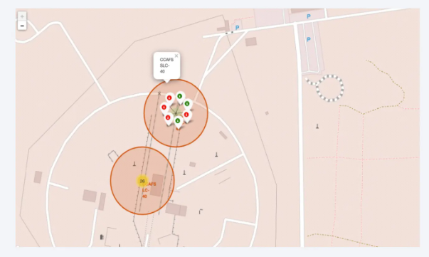
All success and failed launches for each sites on a map
The launch records are grouped in clusters on the map, then labelled by green markers for successful launches and re markers for failed ones

Slide 37
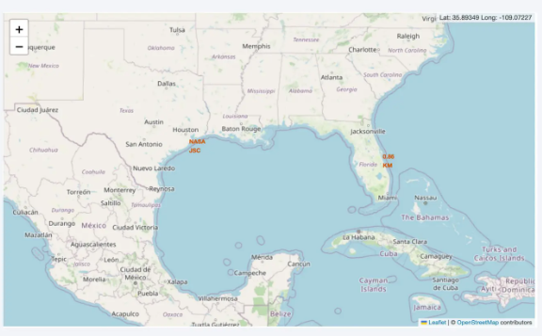
Distance between a launch site to is proximities
The closest coastline from NASA JSC is marked as a point using Mouseposition and the distance between the coastline point and the launch site is aproxx. 0.86 KM

Slide 38

Section 4

Slide 39
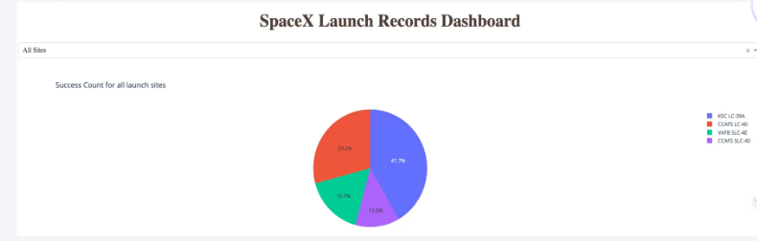
Total successful launches for all sites
KSC LC-39A has the highest amount of successful launches with 41.7% from the entire record, whereas CCAFS SLC-40 has the lowest amount of successful launches with only 12.50%

Slide 40
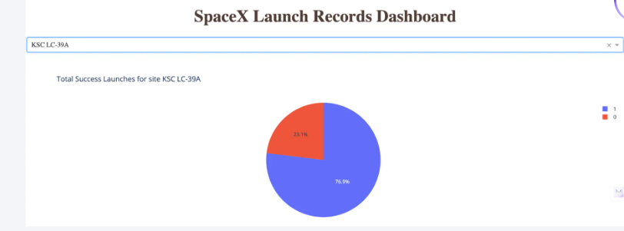
Success ratio of the launch site with the highest successful launches
KSC LC-39A which is the launch site with highest amount of success, has a 76.90% success rate for the launches from its site and 23.10% failure rate

Slide 41
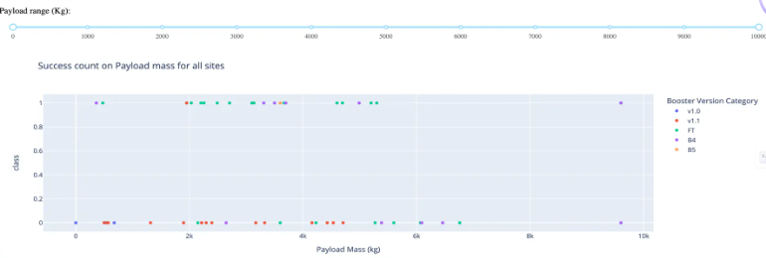
Payload VS Launch outcome
The payload range that has the highest success launches is between 2000 to 4000 kg , which can be seen by the most number of plots in that range, followed by the payload range of 4000 to 6000 kg with the second most number of plots

Slide 42

Section 5

Slide 43
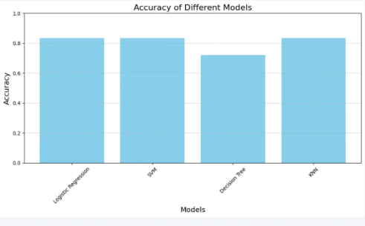
Classification Accuracy
Logistic Regression (LR), Support Vector Machine (SVM), and K-Nearest Neighbors (KNN) are the top-performing models for predicting landing outcomes with thw accuracy of 83.33%

Slide 44
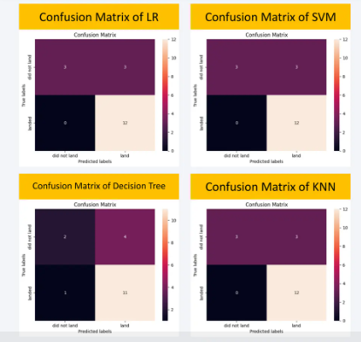
Confusion Matrix
LR,SVM,KNN models are good as their confusion matrix shows that they predict all 12 successful landing correctly, with zero error.
However, the decision tree model only predicted 11 successful landing with on wrong prediction
Logistic Regression (LR), Support Vector Machine (SVM), and K-Nearest Neighbors (KNN) are the top-performing models for predicting landing outcomes with same accuracy 83.33%

Slide 45
Conclusions
Logistic Regression (LR), Support Vector Machine (SVM), and K-Nearest Neighbors (KNN) are the top-performing models for predicting landing outcomes.
Lighter payloads show a higher success rate compared to heavier ones.
GEO, HEO, SSO, and ES L1 orbit types demonstrate the highest rates of successful launches.
Launch Complex 39A (KSC LC-39A) at the Kennedy Space Center records the most successful launches overall compared to other sites.

Slide 46
Appendix
Link: https://github.com/YogitaGohiya/Space-X-Falcon-9-First-Stage-Landing-Prediction/tree/main

Slide 47


